Slide 1
Wireless Metropolitan Area Network

Slide 2
WMAN
What is WMAN?
MAN used optical fiber or wireless infrastructure.
Cover large geographical area.
It use radio waves or Infrared light.
Moderate-to-high data rate used .
It operated by own or single organization.
50km range.
It use broadband wireless access technology.
WMAN use IEEE 802.16 standard.
WMAN examples:
The network connecting different branches of a company in same city.
The network connection different campuses of a collage in a city.
Cable TV network in a city

Slide 3
WiMAX
What is WiMAX?
Used for Long-range wireless network.
It was developed by WiMAX forum in 2001.
It provide 10mgbt/s for upload and download 10km distance.
455 WiMAX n/t have been deployed in over 135 countries.
The hottest broadband wireless technologies.
Also Know as “standards-based technology.
Its operates over licensed and non-licensed frequencies using
NLOS
LOS

Slide 4
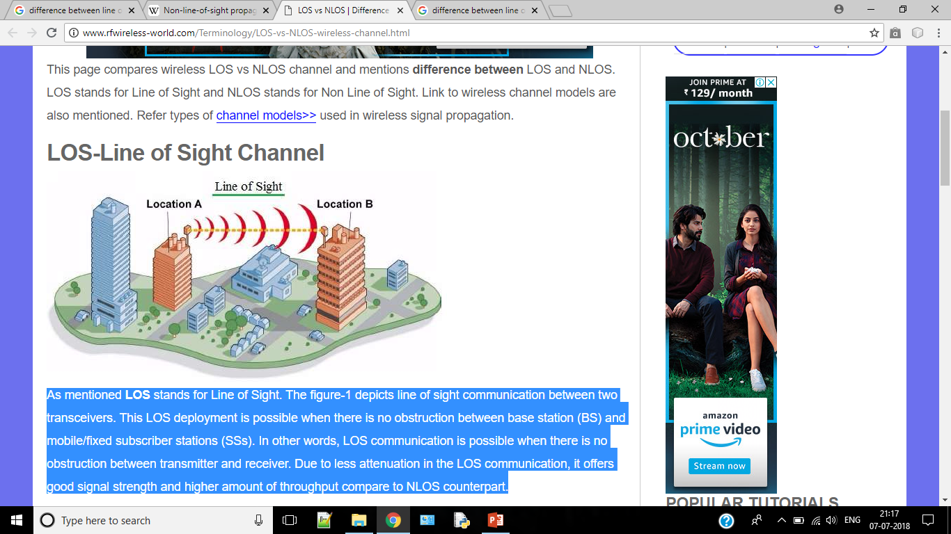
LOS
What is LOS?
Sight communication between two transceivers
No obstruction
Stronger connection and more stable
Higher throughput
Use high frequencies.
Higher range can be achieved
Examples of LOS wireless link: • Microwave point to point communication • point to point connection between BS and SS.

Slide 5
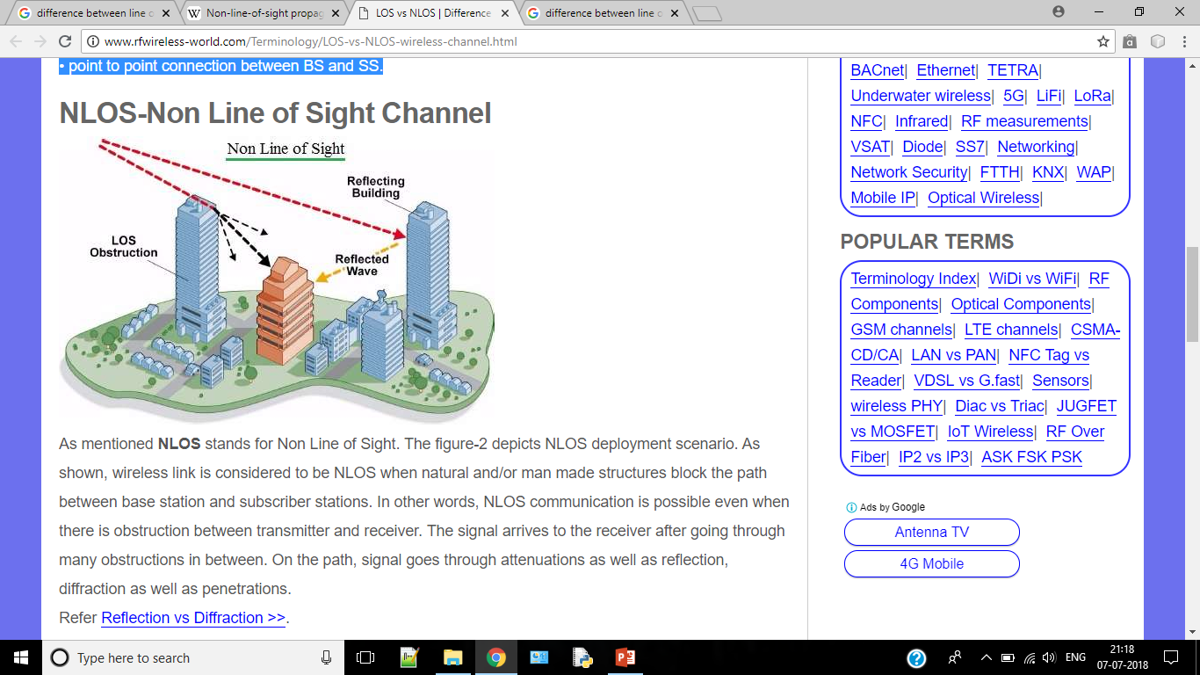
NLOS
What is NLOS
Natural and/or man made structures block the path
Uses lower frequency range
Create multiple signals
Examples of NLOS wireless link: • Wireless connection between BS (Base Station) and SS (Subscriber station) / MSS (Mobile Subscriber Station)

Slide 6
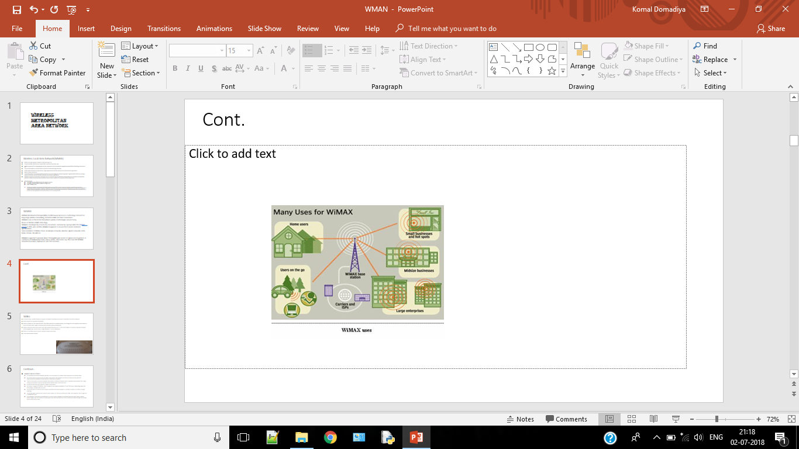
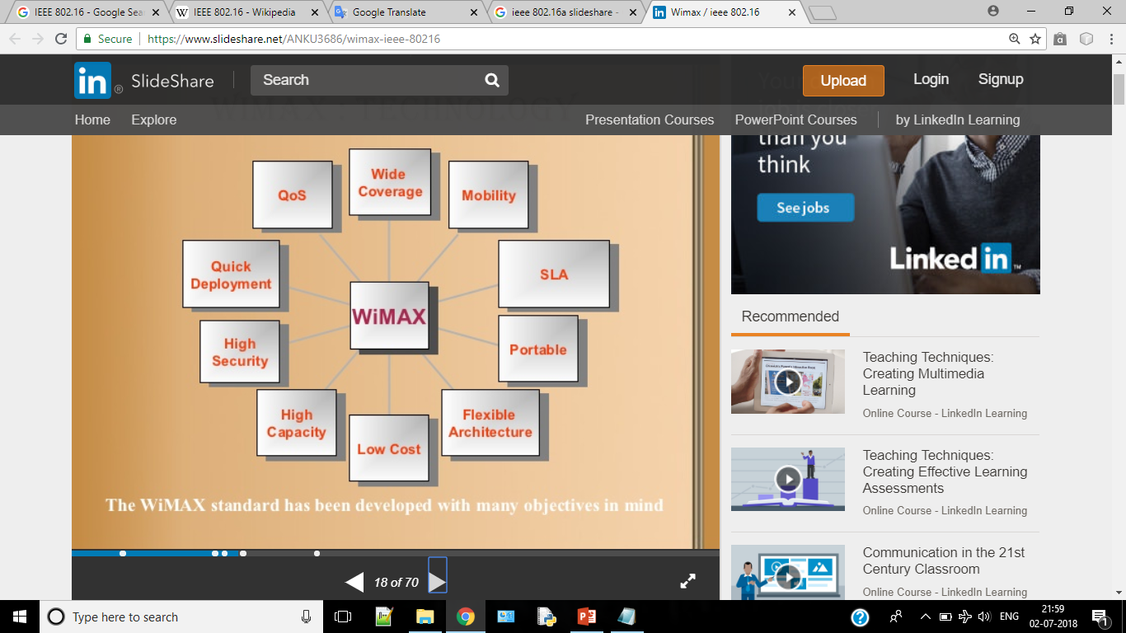

Slide 7
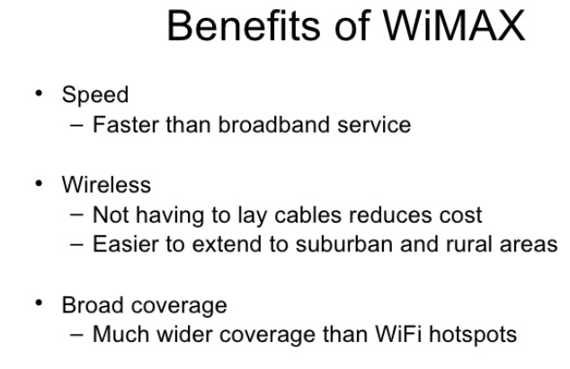
WiMAX

Slide 8
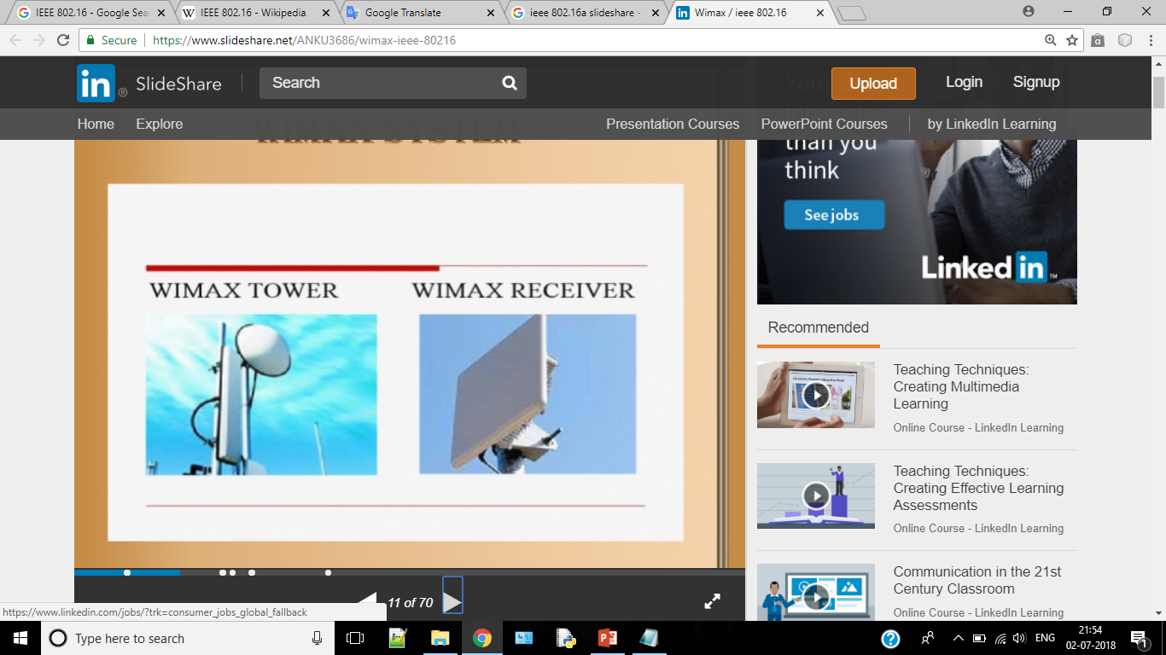

Slide 9
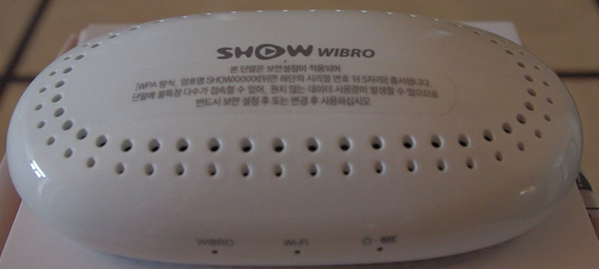
WiBro
In South Korea, mobile WiMAX is known as wireless broadband and work as wireless local area network.
What is Wibro?.
WiBro is based on the same IEEE 802.16e-2005 standard as mobile WiMax, but designed to be slightly more robust in terms of subscriber’s speed compare with the base station bandwidth.
Wibro communication technique uses radio waves (frequency of 2.3 GHz) and allows a maximum theoretical speed of 30 megabits per second over a range between 1 and 5 kilometers.
Wibro is a wireless point to point communication technique.
It use time-division duplex.

Slide 10
IEEE 802.16
IEEE 802.16 is a series of wireless broadband standards written by IEEE.
The IEEE Standards Board established a working group in 1999 to develop standards for broadband for wireless metropolitan area networks.
IEEE 802.16 wireless service provides a communication path between a subscriber site and a core network

Slide 11
IEEE 802.16 Standards
802.16a
It was approved in January 2003 and released in April 2003
This standard added PHY layer support for 2-11GHz
Licensed and license exempt band is included
NLOS operation becomes possible due to 11GHz range
Extend geographical range of the network
Advanced power management technique and adaptive antenna arrays were included for solving multipath propagation problem of NLOS.
OFDM technique was included for employing
Security was improved and many privacy layers become mandatory
Add optional supports for mesh topology in addition to point-to-multipoint
Its supports in voice and video application
Broadband connectivity is possible without requiring LOS.
802.16c
Developed in Dec 2002 and released in January 2003
The 802.16c was developed for wireless networks operating on licensed radio-frequency (RF) bands between 10 GHz and 66 GHz.
It is concerned with detailed system profiling, performance evaluation, and testing.
The aim was to enable greater levels of interoperability.

Slide 12
IEEE 802.16 Standards
802.16-2004(d)
Developed in 2004 but release in june 2005
It supports fixed and limited portability service
It use data connectivity and VoIP application
It reduces over head
Improve Qos
Addresses Polling request to reduce collisions
It also allows vender to develop product for testing
802.16e
Amendment of 802.16
Developed in Dec 2005
Use 2-6GHz spectrum
Used in mobile internet
Use NLOS technology
Data rate is upto 15Mbps
This standard add :
mobile supportively to fixed broadband
Support smart antennae
MIMO
Competes with 3G network

Slide 13
IEEE 802.16 Standards
802.16m
Future fourth generation standards.
Use 1 GBPS data rates
Backwards compatible to 802.16e

Slide 14
Advantages IEEE 802.16
Last-mile connectivity
Roaming Networks
Flexibility
Scalability

Slide 15
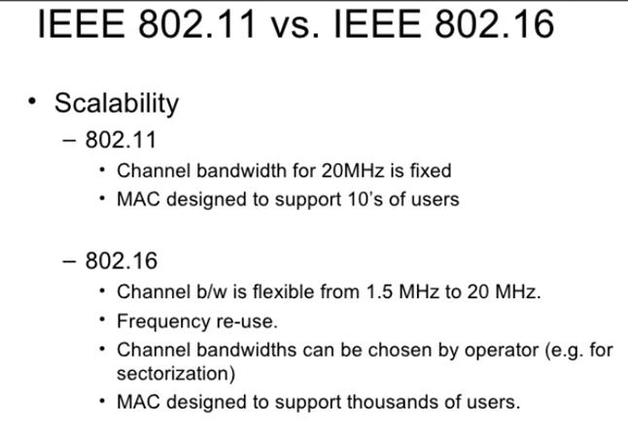

Slide 16
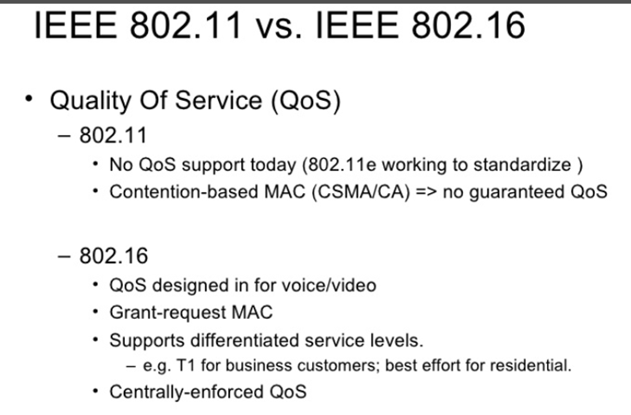

Slide 17
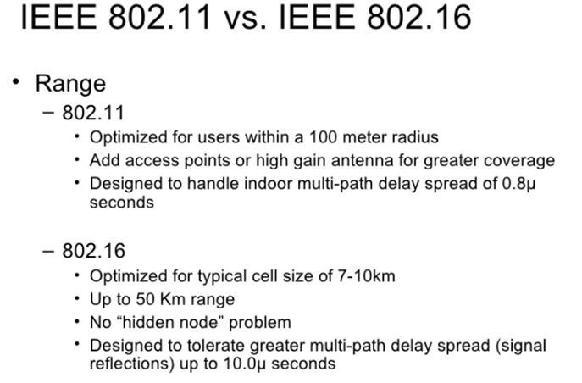

Slide 18
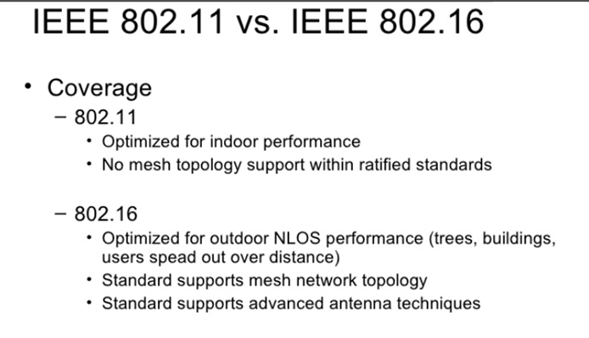

Slide 19
WMAN network architecture
WiMAX is a separate radio system
It competes with 3G and ISP.
Home and business subscriber to a WiMAX service.
WiMAX is an extension for internet and PSTN to the mobile user.
Its use simple IP-based backhaul connections.

Slide 20
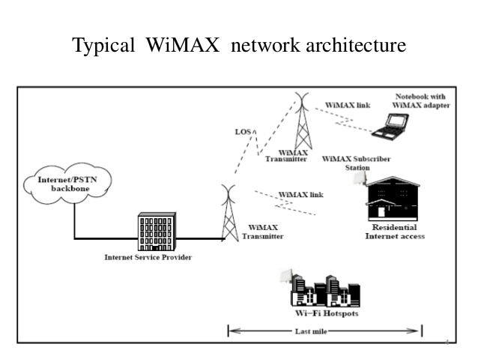
WMAN network architecture

Slide 21
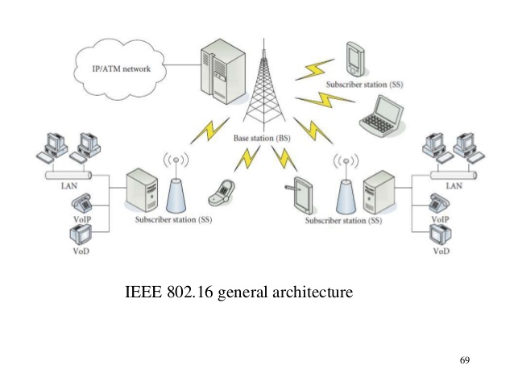

Slide 22
WMAN Network Components
WiMAX base station
WiMAX receiver
Backhaul

Slide 23
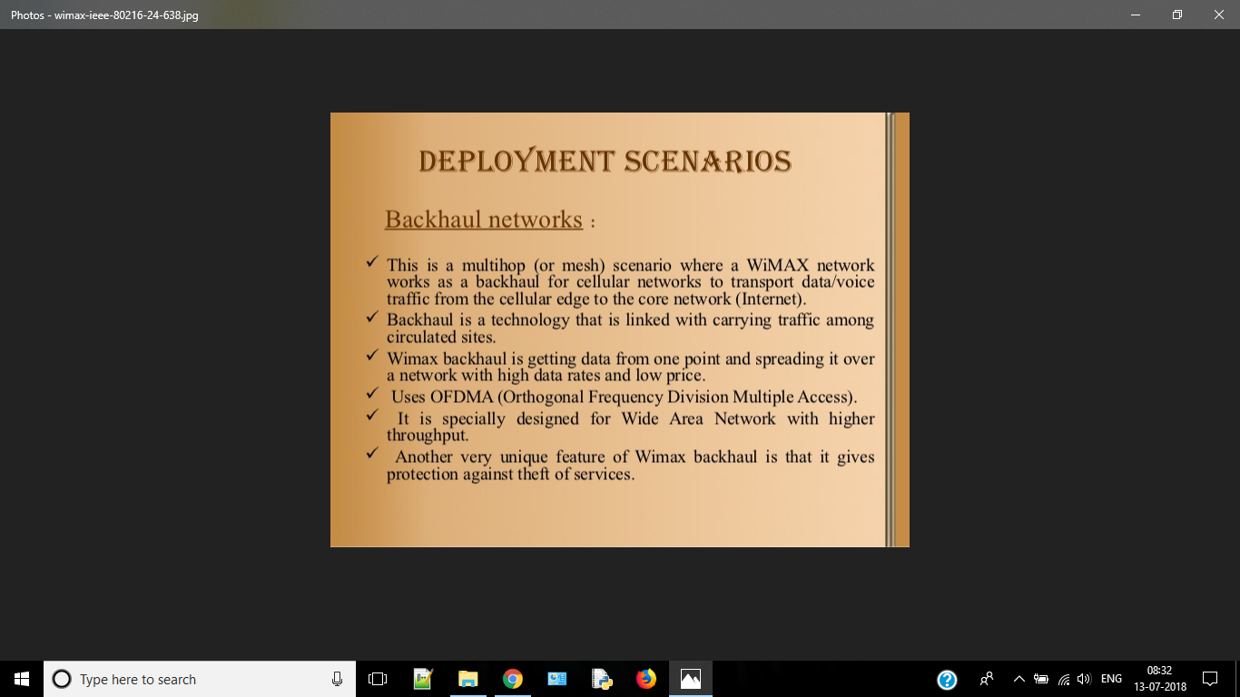

Slide 24
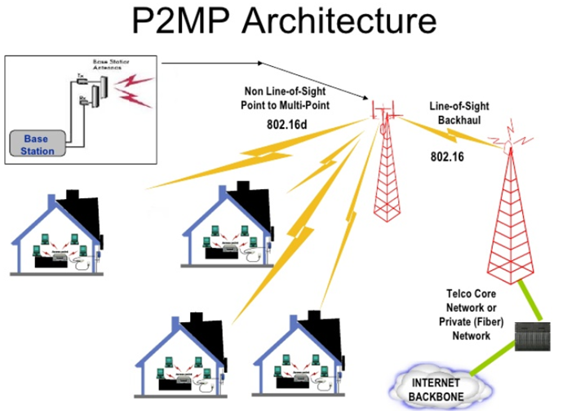
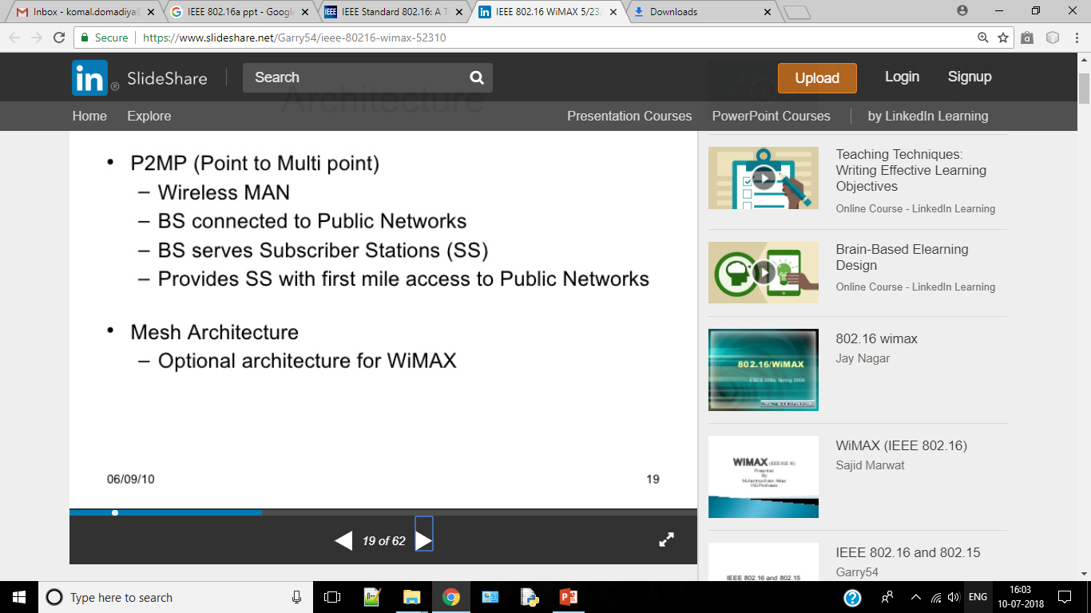
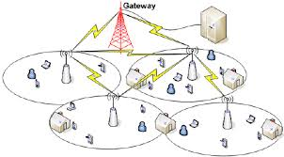

Slide 25
Feature of WiMAX
Flexible architecture
High security
WiMAX QoS
Quick deployment
Multilevel service
Interoperability
Portability
Mobility
Cost-effective
Wider coverage
NLOS operation
High capacity

Slide 26
WiMAX Mobility Support
Nomadic
Portable
Simple mobility
Full mobility

Slide 27
WiMAX Applications
WiMAX network applications are grouped in to :
Public network application
Private network application

Slide 28
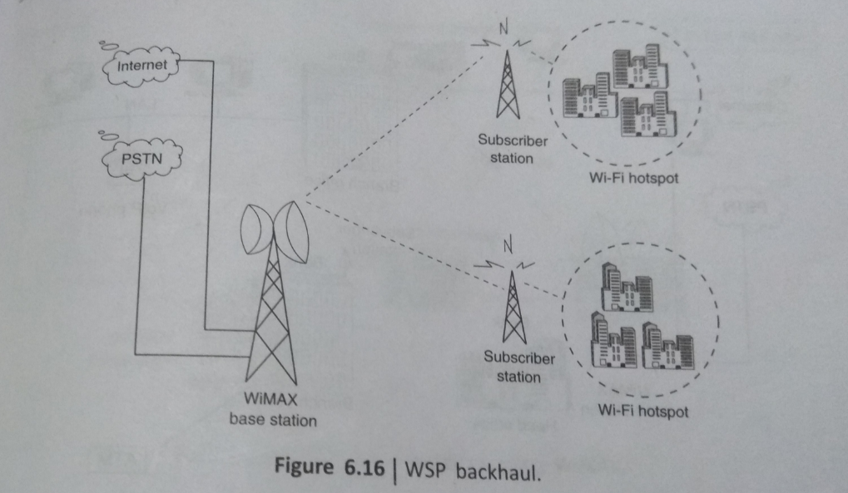

Slide 29
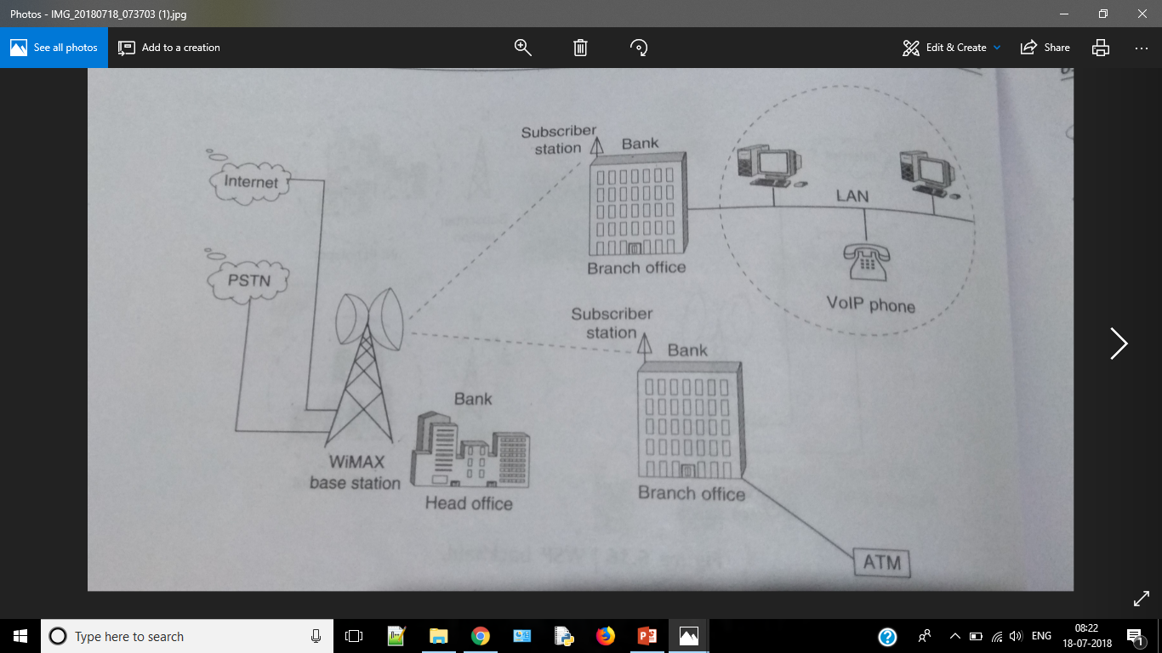

Slide 30
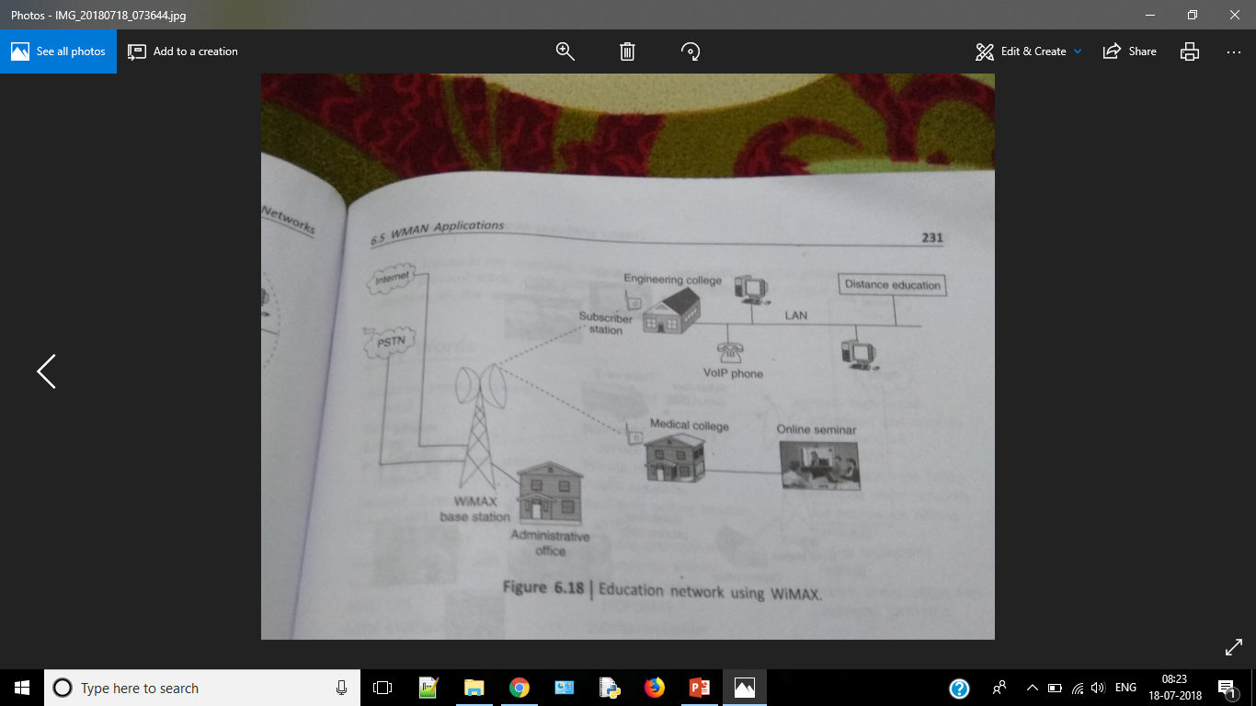

Slide 31
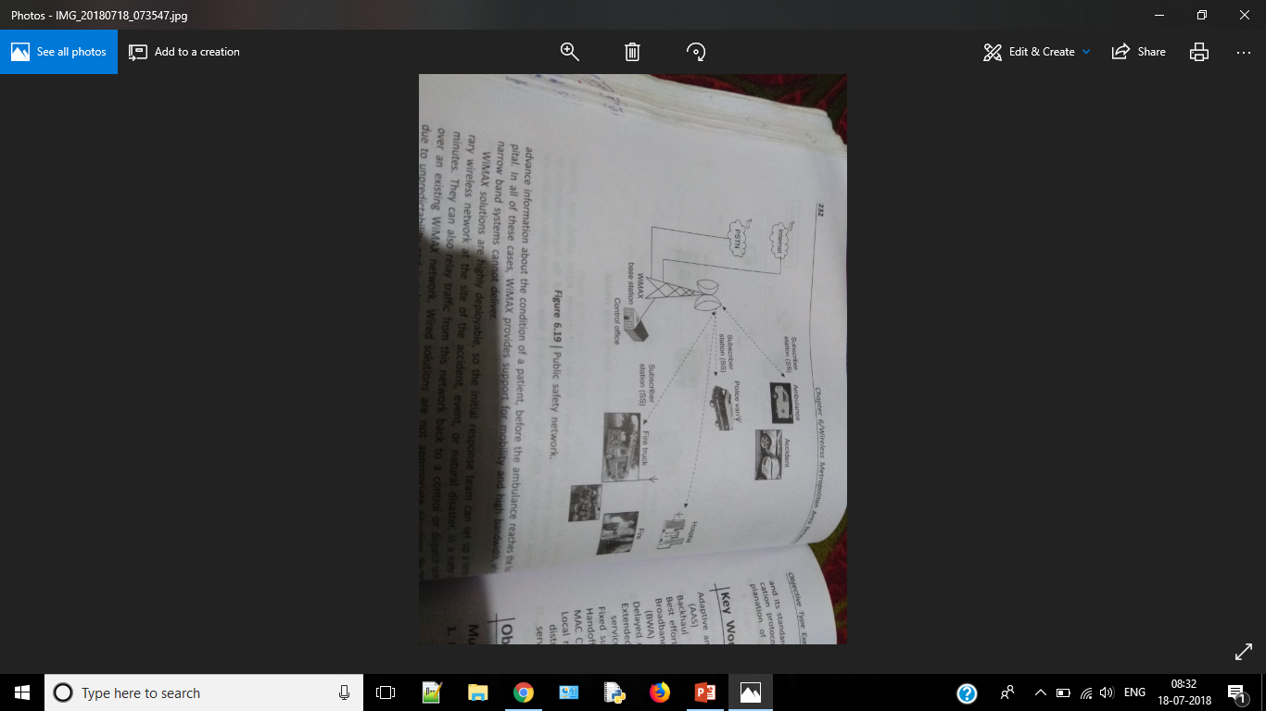

Slide 32
WiMAX
WiMAX Qos services:
Unsolicited grant service is a service flow in which the transmission system automatically and periodically provides a defined number of timeslots and fixed packet size that is used by a particular receiver.
The rtPS(real-time Polling Service) algorithm is designed to support real-time service flows, such as MPEG video or tele-conference, that generate variable size data packets periodically.
The ertPS (extended real-time Polling Service) class was added by the 802.16e amendment. The standard indicates that ertPS is a scheduling mechanism that builds on the efficiency of both UGS and rtPS.
The nrtPS(non-real-time Polling Service) is designed to support delay-tolerant data streams consisting of variable-size data packets for which a minimum data rate is required.
The BE(Best effort) service is designed to support data streams for which no minimum service guarantees are required and therefore may be handled on a best available basis.

Slide 33
Broadband Wireless Network
Broadband Wireless Network Technologies are:
Wireless Local Loop
Local Multipoint Distribution Service
Multichannel Multipoint Distribution Service
Wireless ATM
Wireless Local Loop
Interoperability requirement are less stronger than mobile service.
There are several standards and commercial system.
Mobile service is not needed.
Its architecture is simple.
Point-to-Point.
Microwave platform.
This reduces the cost and time for planning miles of cable.

Slide 34
Cont.
FSU : Fixed Subscriber Unit
RP : Radio Port
RTU : Radio Transceiver Unit
RPCU : Radio Port Control Unit
FWNIU: Fixed Wireless Network
Interface Unit
BSC : Base Station Controller
BTS : Base Station Transceiver System
TNU : Transcoding and Network Interface
Unit
HLR/VLR: Home and Visitor Location Register

Slide 35
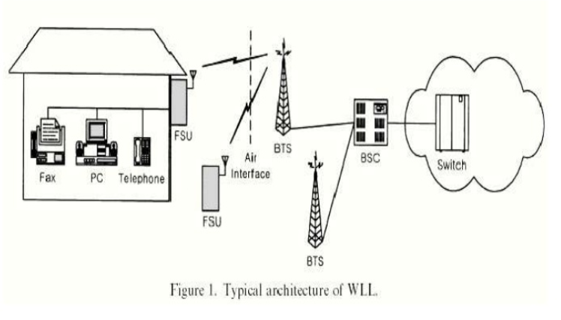

Slide 36
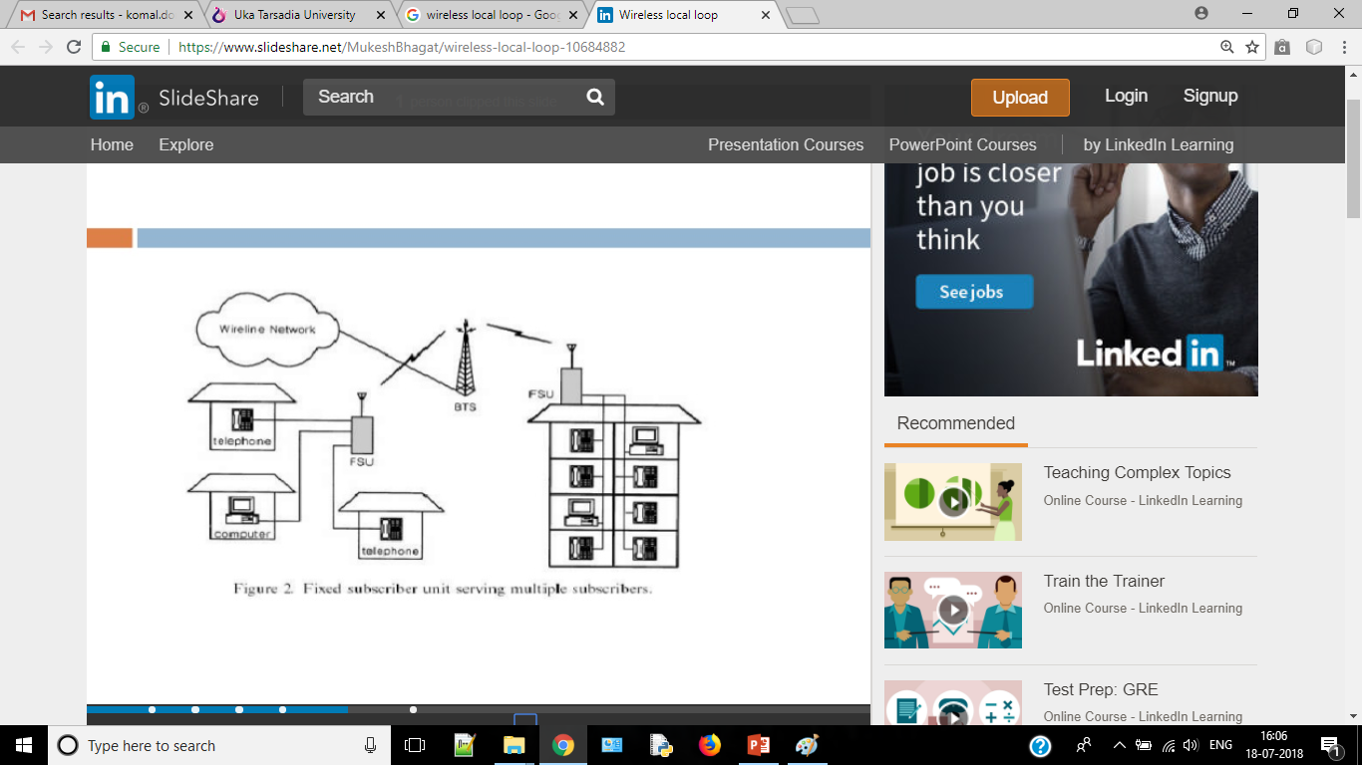
FIXED SUBSCRIBER UNIT
It is an Interface.
FSU also know as WAFU or RSU or FWNIU.
Perform channel coding/decoding, mod./demod.,
transmission /reception of signal via radio.
Also perform source encoding/deco.
It support voice-band modems for network connec.
Radio Band Conne.
Use around 2 GHz Freq.
Fixed service.
Use High-gain direct antennas..
Follow LOS Technology.
It also integrated with handset.
High-capacity.
Where FSU used?
Its also provide features services.

Slide 37
Base Station
BS implemented two parts:
BST
BSC
BST:
Perform channel coding/decoding, mod./demod.,transmission /reception of signal via radio.
It also refer as RP or RTU.
BSC:
BSC controls one or more BTSs.
Provides an interface to the local exchange (switch) in the central office.
Transcode between the source codes used in wired network and that at the air interface.
BSC is also called the RPCU or TNU.

Slide 38
Local Multipoint Distribution Service
B-WLL supports multimedia services.
LMDS is strongest candidate of B-WLL.
Offer video tele., video-on-demand, and high-speed Internet access.
Operating P2P comm.
Use 20GHz.
Its provide two-way voice, data, internet and video services.
LMDS acronym from:
L(local)
M(Multipoint)
D(Distribution)
S(Service)
P2P
Provide high-speed.
fixed WN.
P2MP is recent advance Tech.
High-capacity
Faster to deploy
Cost effective

Slide 39
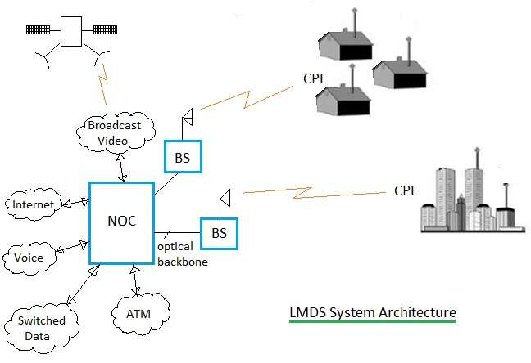
Cont.
It proved last-mile solution.
Various network archi are possible in LMDS system design
P2P
P2MP
TV Distribution Sys.
LMDS Architecture:

Slide 40
Cont.
Its combination of voice, data, video.
Use ATM and IP(in large telecom infrast sys).
LDMS consist:
Network Operations Center
Fiber-based Infrastructure
BS
CPE

Slide 41
Cont.
NOC manage large regions of customer network.
Multiple NOC can interconnect.
Fiber-based infrastr consists central-office, ATM, IP, Optical carrier Internet and PSTNs.
BS is intercafe between fibered and wireless infra.
BS equipment includes fiber termination, modu/demodu function, microwave transmi and reception equipment(antenna)
BS simply provide connection to fiber infrastu.
Centralized location is required between sender and receiver.
i.e. Billing, registration, traffic mgnt etc.
CP configurats vary widely from Vendor to Vendor will include outdoor-mounted microwave equipment and indoor digital equipment(modu/demod,control ect).
CPE attach network using TDMA, FDMA and CDMA methods.

Slide 42
Multichannel Multipoint Distribution Service
What is MMDS?
It is used for small business and home offices.
It is not used for large customer requirements such as central offices.
It is used where other broadband wireless technologies are difficult to be installed.
It uses microwave tower installed on top of the mountains or tall buildings.
It covers larger distance compare to LMDS which is about 35 miles.
Its is the fiber-replacement techno intended for higher density in urban areas.
Its use P2MP archite.
Follows MAC and PHY layer.
Following are the key features of MMDS system: - It operates in 2.5 GHz and 3.5 GHz frequency bands. - Hub tower has coverage distance of about 35 miles. - It uses both P2MP and P2P topologies.

Slide 43
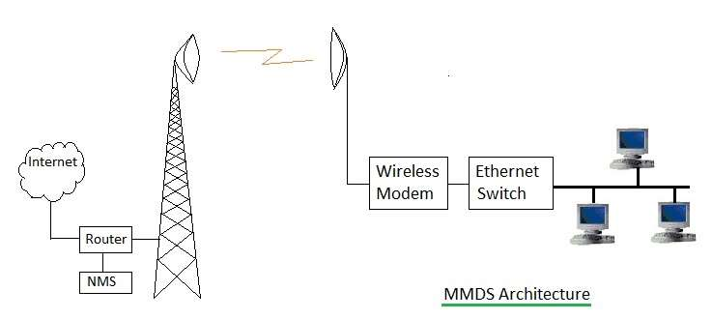
MMDS Architecture
It consists of Hub equipment and customer side equipment.
Hub consists of antenna tower, RF equipment, Modem, Router for connection with internet and network management system
Customer side equipment include antenna, wireless modem, ethernet switch, PCs etc.
Hub antenna tower receives wireless signals from multiple users similar to P2MP topology.
Each user premise antenna and Hub antenna is connected with P2P microwave link.

Slide 44
Comparison of LMDS and MMDS
Parameter | LMDS | MMDS
Full Form | Local Multipoint Distribution Service | Multichannel Multipoint Distribution Service
Architecture | The LMDS architecture consists of NOC (Network Operation Center), BS, CPE and Fiber backbone. It has cellular like architecture. | The MMDS architecture consists of tall antenna tower, backbone internet connectivity using router and network management system. It has microwave link like architecture.
Frequency of operation | 28 GHz, 36 GHz | 2.5 GHz, 3.5 GHz
Network Topology | P2MP (Point to Multi-point) | P2P (Point to Point)
Distance coverage | Good more smaller distances. (2 to 8 Km) | Covers larger distance. (50 to 100 Km)
Number of cells | more | very few
Data rate | 1 to 10 Mbps | upto 2 Mbps
cost | CPE cost and deployment cost is medium to high. | CPE cost and deployment cost is low compare to LMDS.

Slide 45
Cont.
LMDS
Advantages: • It has larger bandwidth used for wide variety of applications such as voice, IP, data etc. • It supports large capacity of users densely populated by way of sectorizing the area into cells.
Disadvantages: • It has high RF equipment costs due to larger number needed. • Smaller cell size (i.e. 2 to 8 Km) due to requirement of covering large capacity of users. • Requires many cells to cover larger city areas. This increases installation cost for service providers.
MMDS
Advantages: • The RF propagation covers 100 Km of region using single antenna tower. • Due to smaller frequency of use compare to LMDS, MMDS does not suffer from rain attenuation. • RF equipment are cheaper at lower frequency of 2.5GHz or 3.5 GHz and are available in large quantities.
Disadvantages: • It does not support larger capacity due to lack of sectorization concept in MMDS. • It suffers from interference from other MMDS and TV applications. • Large upstream bandwidth needs more and accurate planning.

Slide 46
Wireless ATM
What is ATM
ATM supports voice, video and data allowing multimedia and mixed services over a single network.
Cable can be twisted-pair, coaxial or fiber-optic
Ability to connect LAN to WAN
ATM is considered to reduce the complexity of the network and improve the flexibility while providing end-user consideration of traffic performance
ATM technology uses ATM cells for data transmission between source and destination.
ATM cell uses fixed size of 53 bytes which consists of header (5 bytes) and data (48 bytes).
It is behind the success of B-ISDN used for voice/data/video transportation
ATM transmits cells only when there is data to be transmitted unlike Synchronous Transfer Mode where bandwidth is assigned periodically like TDM.
ATM is connection oriented which uses virtual packet switching.
Multiple logical connections are multiplexed over single physical connection

Slide 47
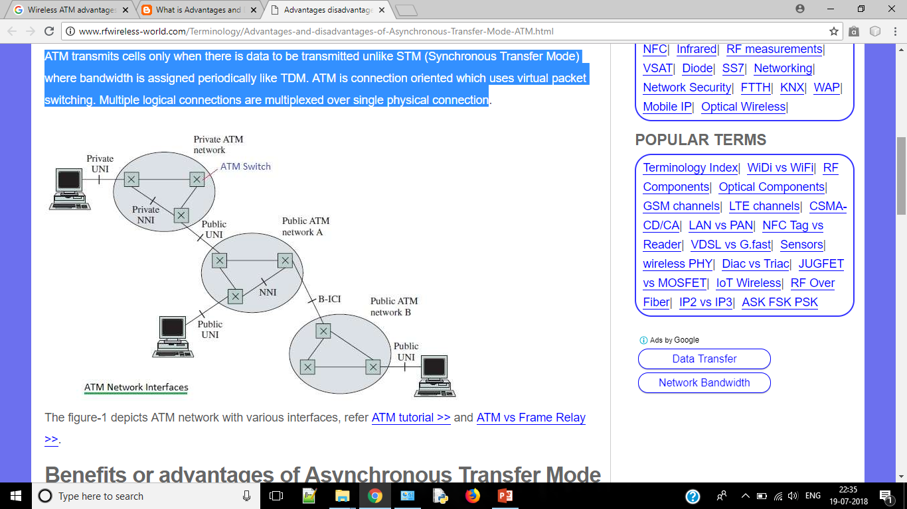
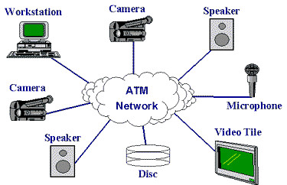
Cont.
Advantages
➨It is optimized to transport voice, data and video i.e. single network for everything. It is used for mixed traffic, real-time and non real time traffic types. ➨It is easy to integrate with LAN, MAN and WAN network types i.e. seamless integration. ➨It is QoS oriented and high speed oriented. ➨It enables efficient use of network resources using bandwidth on demand concept. ➨It uses simplified network infrastructure.
Disadvantages ➨Overhead of cell header (5 bytes per cell) ➨Complex mechanisms are used to achieve QoS. ➨Congestion may cause cell losses ➨ATM switch is very expensive compare to LAN hardware. Moreover ATM NIC is more expensive compare to ethernet NIC. ➨As ATM is connection oriented technology, the time required for connection setup and tear down is larger compare to time required to use it.

Slide 48
Content
Virtual circuit switching is a packet switching methodology whereby a path is established between the source and the final destination through which all the packets will be routed during a call
connection-oriented describes a means of transmitting data in which the devices at the end points use a preliminary protocol to establish an end-to-end connection before any data is sent. Connection-oriented protocol service is sometimes called a "reliable" network service, because it guarantees that data will arrive in the proper sequence. Transmission Control Protocol (TCP) is a connection-oriented protocol.
ISDN stands for Integrated Services Digital Network. It is a design for a completely digital telephone/telecommunications network. It is designed to carry voice, data, images, video, everything you could ever need.
Seamless integration is the process where a new module or feature of an application or hardware is added or integrated without resulting in any discernable errors or complications. It simply means that whatever change is being applied to a system, it happens without any negative impact resulting from the integration.

